Slide 1


Extend your PowerShell Skills by creating Azure DevOps Extensions
Stefan Stranger
@sstranger
https://github.com/stefanstranger
Notes:
This is the slide shown before the presentation starts. When you are ready to go, tell the video operator to start the recording, and click to the next slide.

Slide 2
5
Video operator, did you start the recording?
Notes:
[REQUIRED SLIDE]
These slides are mandatory and help us with video post-processing. Please keep them as they are.

Slide 3
4
Notes:
[REQUIRED SLIDE]

Slide 4
3
Notes:
[REQUIRED SLIDE]

Slide 5
2
Notes:
[REQUIRED SLIDE]

Slide 6
1
Notes:
[REQUIRED SLIDE]

Slide 7
How to insert your Twitter handle
1. On the Insert tab, select Header & Footer.
2. On the Slide tab, check the Footer box.
3. In the box below Footer, type your Twitter handle (e.g. @PSConfEU).
4. To prevent the footer from appearing on the title slide, check the Don't show on title slide box.
5. Click Apply to All button.

Slide 8
Extend your PowerShell Skills by creating Azure DevOps Extensions
Stefan Stranger
@sstranger
https://github.com/stefanstranger
Notes:
This is the slide shown before the presentation starts. When you are ready to go, tell the video operator to start the recording, and click to the next slide.

Slide 9
Goals
Learn about Azure DevOps Extensions
Learn how to leverage your existing PowerShell knowledge to create Azure DevOps Extensions
Notes:
Please invest some time to reconsider your session: what is it that audience can get out of it? Try and be as precise as you can. If you are showing solutions, then focus on “how to”. If you present about a general technology, you’ll want to stick to “Be able to” or “Understand why/how”.

Slide 10
Agenda
Outline your presentation here
Keep bullets to one line
Do not use linebreaks, be precise and on point!
Try and avoid 3rd level bullets
Keep need for slides to a minimum
Use demos instead
This is an example of the “Title & Non-bulleted text” layout.
Notes:
Psconf.eu is about demos and code. Try and minimize use of text slides

Slide 11
Agenda
What is Azure DevOps?
What is an Azure DevOps Extension?
Extension Components?
Demo’s
Notes:
Psconf.eu is about demos and code. Try and minimize use of text slides

Slide 12

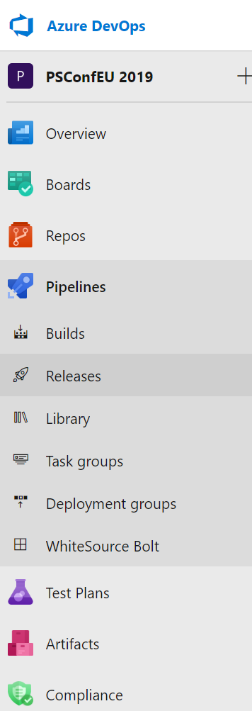
Azure DevOps
AKA VSTS
Azure DevOps is a Software as a Service that provides development collaboration tools including:
high-performance pipelines
free private Git repositories
configurable Kanban boards
extensive automated and cloud-based load testing

Slide 13

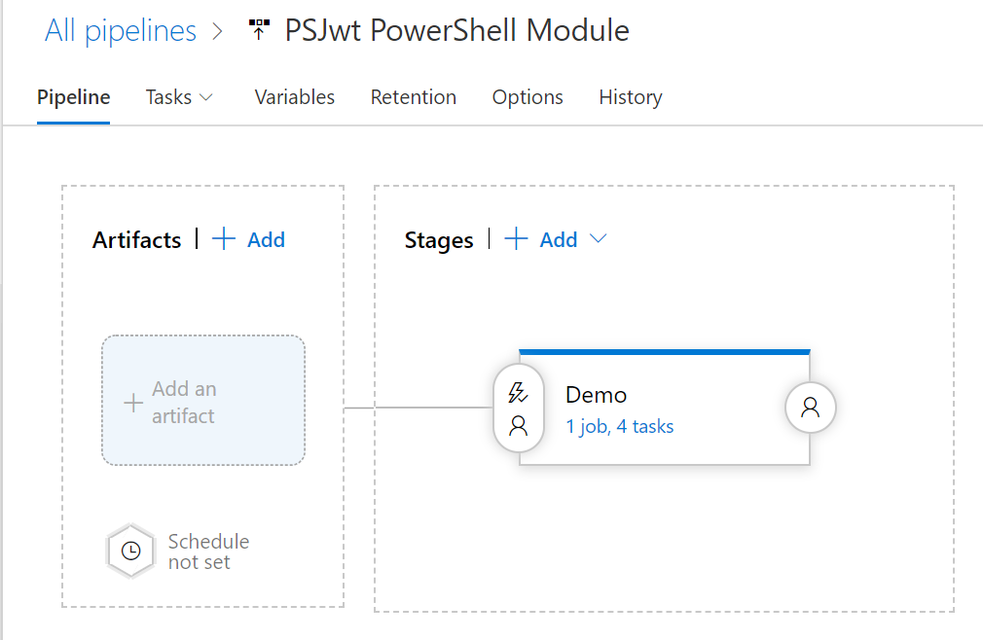
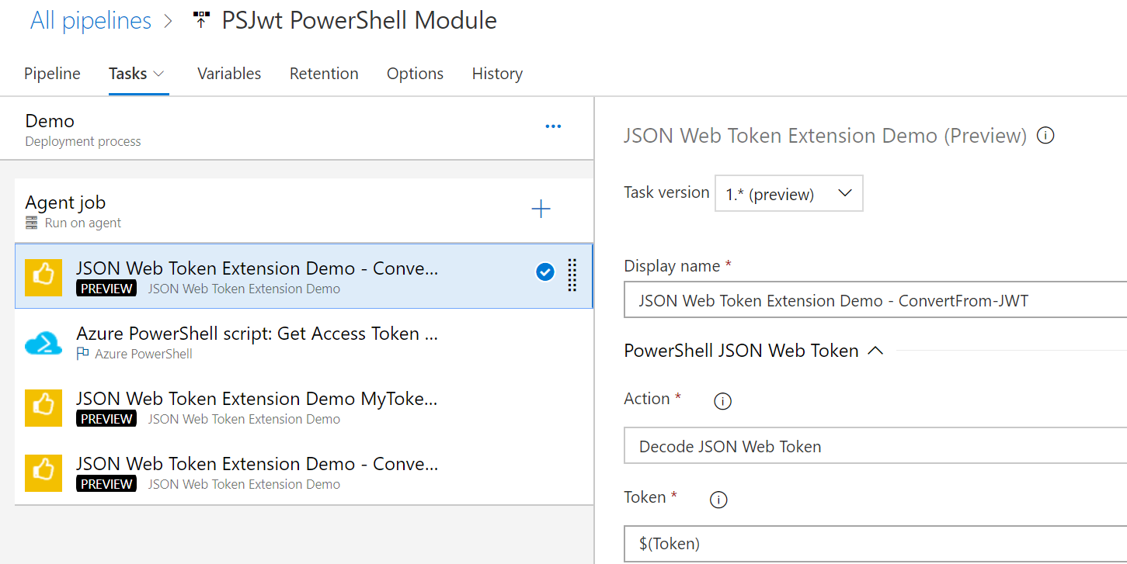
Pipelines

Slide 14
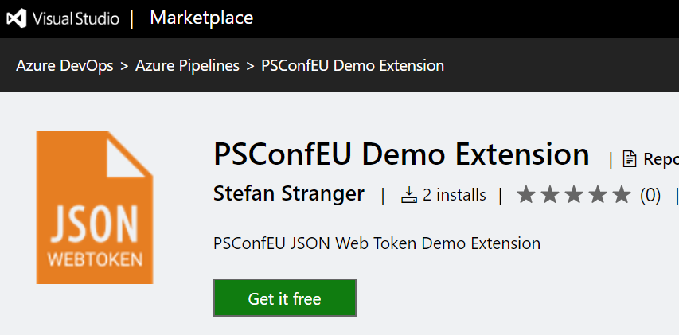
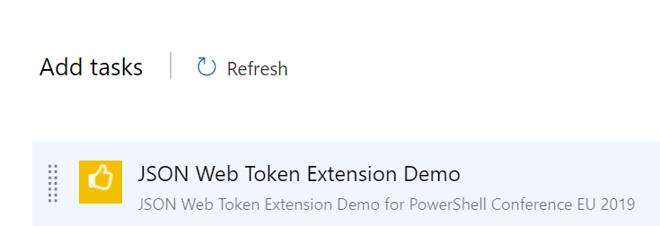
Azure DevOps Extensions?
Extensions are add-ons for Azure DevOps
Can be used in Azure DevOps Pipelines
Published in Visual Studio Marketplace

Slide 15
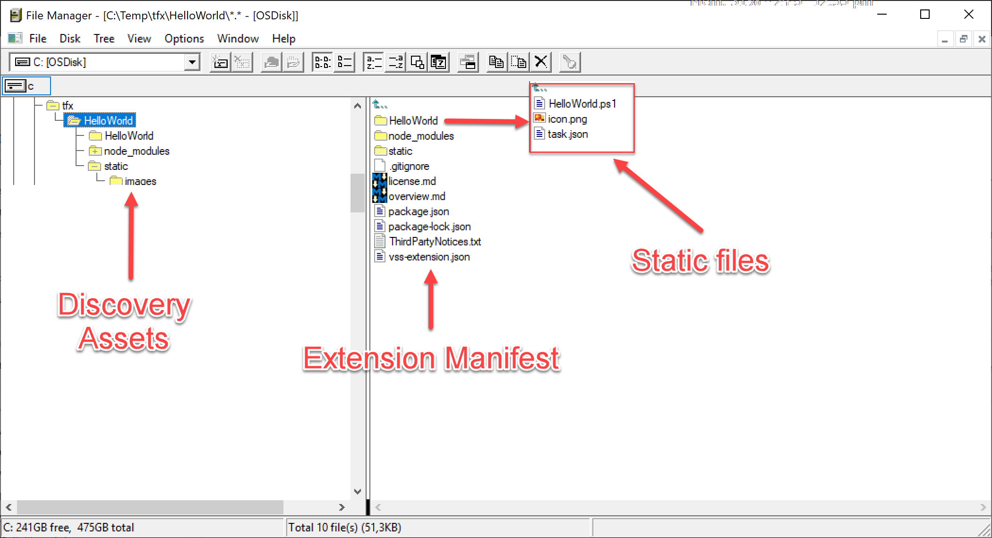
Azure DevOps Extension - Components
Notes:
A JSON manifest file contains basic info about the extension.
Discovery assets - the markdown and images that make up your extension's overview and aesthetics in the marketplace.
Static files that contain the logic of your extension, including HTML, JS, and CSS files. Static files are only applicable to contribution-based extensions.

Slide 16
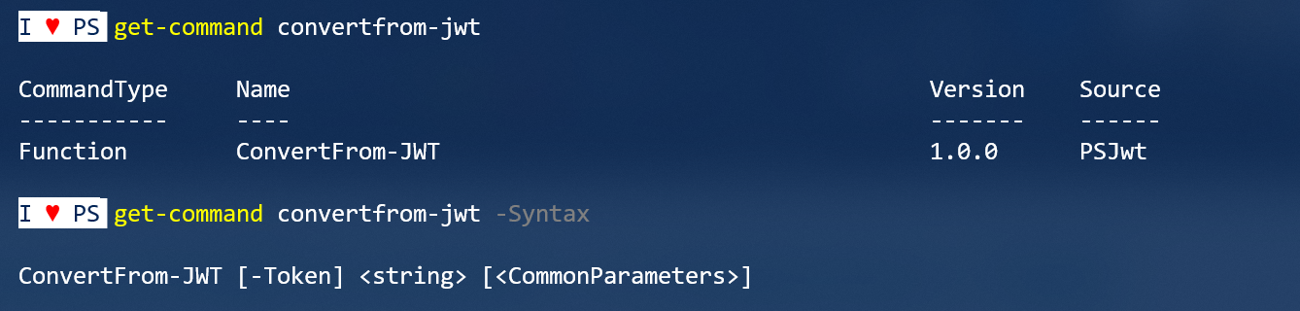
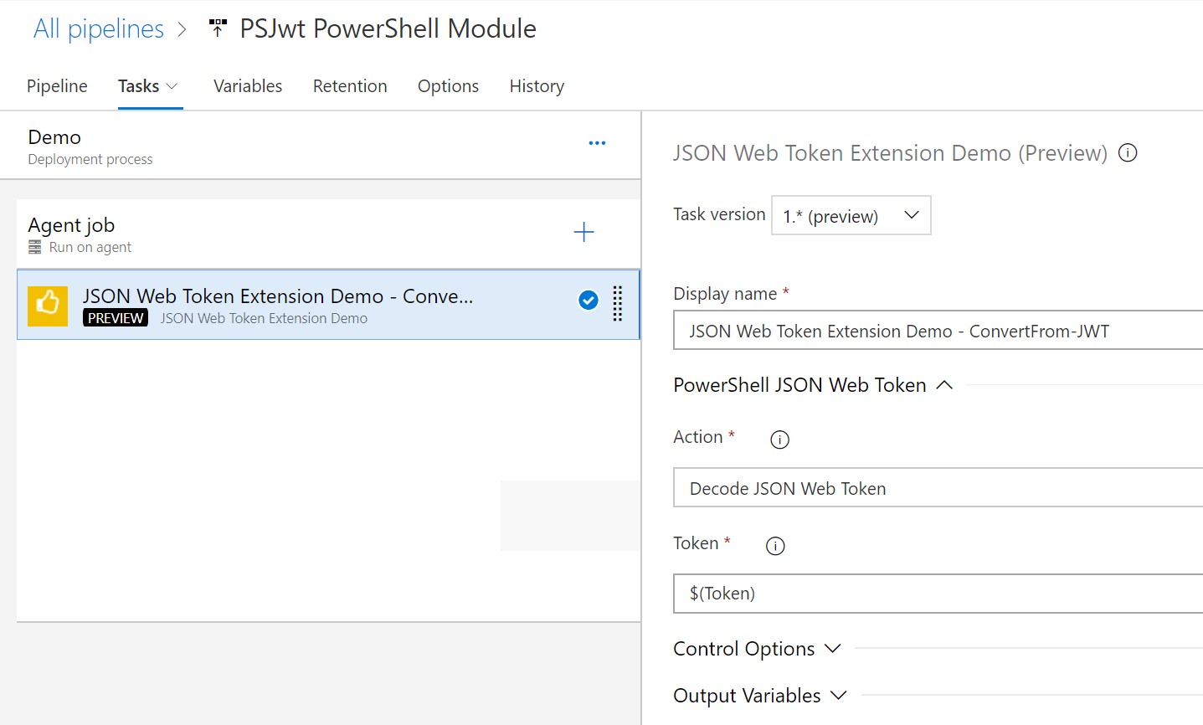
PowerShell function vs Extension Task

Slide 17

PSJwt PowerShell Module
PowerShell Module for JWT (JSON Web Tokens)
JWT is a JSON-based open standard for creating access tokens
Password
Client
Authorization Server
Password
Token
What is the user (authenticated) allowed to do? What resources can the user access?
User
Token
Resource Server
Resource
Notes:
From: https://logcorner.com/angular-js-token-based-authentication-using-asp-net-identity-and-asp-net-web-api/
https://dev.to/siwalikm/what-the-heck-is-jwt-anyway--47hg

Slide 18
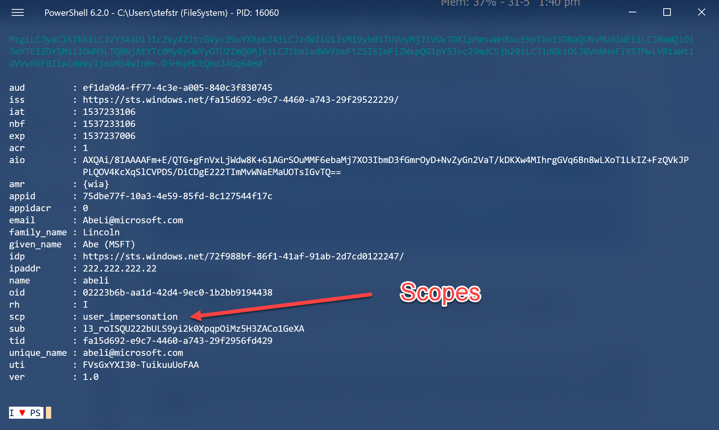
Notes:
https://docs.microsoft.com/en-us/azure/active-directory/develop/access-tokens

Slide 19
Azure DevOps Extension – Development Steps
Develop
Install prerequisites
Create directory & manifest
Package & Publish
Create Publisher
Package Extension
Publish Extension
Test Extension
Install Extension
Test Extension

Slide 20
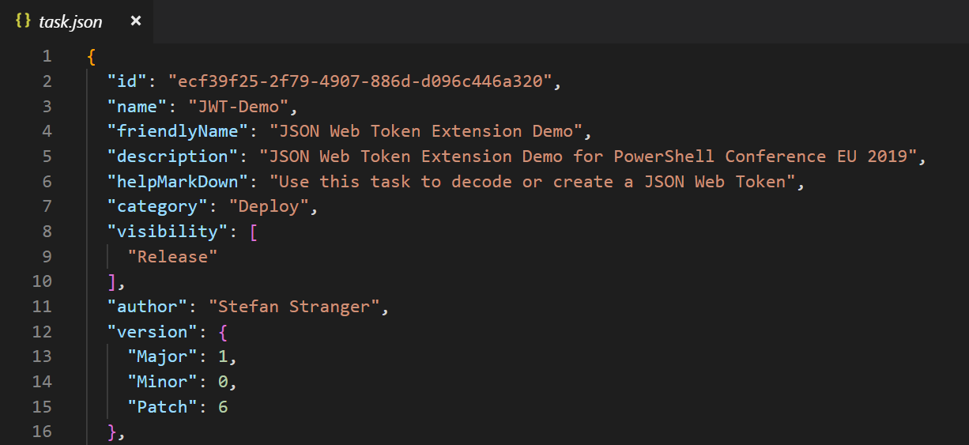
Task.json defines Task UI

Slide 22
Caveats
PowerShell Task is not cross-platform (only works on Hosted VS2017)
Extension < 50 mb

Slide 23
Summary
What is Azure DevOps?
What are Azure DevOps Extensions?
How to turn your PowerShell module into an Extension
PSExtensionHelper (very alpha version) PowerShell module
Notes:
Sum up your key messages

Slide 24
References
PSJwt PowerShell Module
Online JWT conversion
Blog post - Using the Windows Graph API to set Service Principal as owner of Service Principal
Develop Extensions
Package, publish, unpublish, and install Azure DevOps extensions
Extension manifest reference
Task Schema
Notes:
Sum up your key messages

Slide 25
Notes:
[REQUIRED SLIDE]
Make sure you provide all materials that audience needs to reproduce your demos.
Either upload them as a PowerShell module to www.powershellgallery.com (preferred for reusable functions)
Or, upload them to our github repository (ask the girls at the info desk to provide you with access)
Or, upload them to your own github repository
Please make sure all materials are available by the time your presentation starts, or at minimum upload them right after your presentation

Slide 26
Notes:
[REQUIRED SLIDE]
If you sticked to your timing, you now have 15 min left for Q&A. If you missed your timing, you will have to leave the room when your slot is over. In this case, invite your audience to the coffee break and offer to cover questions there.
IN ANY CASE please point your audience to the conference app and the session voting. By the time the conference opens, the eventraft app *should* have the option to vote on sessions.
Please MAKE SURE you leave your room when your slot is over. The next speaker would like to set him/herself up and get everything up and running.

Slide 27
# Follow these instructions to show perfectly color-coded PowerShell code.
# Paste code to PowerShell ISE, select it, and copy it to the clipboard.
Paste-Code -ToISE | Select-Code | Copy-ToClipboard
# To insert it with full color-coding, paste the code into your slide.
# It will be black, and there is a toolbutton labelled (Ctrl) in PPT.
Click-ToolButton -Choose SymbolWithClipboardAndBrush
# Click the toolbutton, and choose the button that shows a clipboard with a brush.
# This will add color-coding back to the pasted code
PLEASE NOTE: You do not need to use PowerShell ISE to code, or to demo.
Use your preferred editor. With a light theme.
These steps use PowerShell ISE to color-code your code correctly and consistently, and insert the color-coded code into the slide. Please help make all code look consistent. Many thanks!
This is an example of the “Code” layout.
Notes:
To color-code PowerShell code in a consistent way, we ask that you paste your code into PowerShell ISE, select it, and copy it from ISE. Next, paste the code into the text field. It will appear black at first. When you click the small tool button that appears after pasting the code, choose the middle icon with the brush. This adds back the token colors.
Again, use any editor you want during your demos. We ask that you use ISE solely for the purpose of consistently color-coding.
If you use editors other than ISE, make sure you choose a light theme. Dark themes are hard to watch in a presentation room.

Slide 28


about_Speaker
I’m Stefan Stranger
I work at Microsoft as a Consultant
You can find some my open source projects on
Github.
I like to share my knowledge about Azure,
PowerShell and DevOps
Notes:
Do not EVER discuss this slide during your presentation. Please do not take presentation time to talk about yourself more than just a few introductory sentences. Instead, invite interested audience to the coffee break, and then talk about yourself, your job, your services, etc.
Use this slide to sum up your details. It will be part of the conference materials and recorded videos.

